Slide 1

Uncovering Insights in Model Output
Interactive Web-Based Visualization Tool for Planners
Suzie Swim — Bill Hereth
Notes:
Hi everyone—
I’m excited to give you a quick peek at something we’ve been working on at the MPO in Salt Lake City.
It’s an interactive visualization tool that lets us explore travel demand model outputs—quickly, seamlessly, and across multiple dimensions, both spatial and temporal. The objective is simple: to help uncover insights hidden in the data.
Now—I’m not a vendor trying to sell you a product... I’m not a consultant trying to sell you services... As a beloved Schoolhouse Rock character from the 70s once said—I’m just a Bill.
I’m just a Bill who—together with our amazing team at WFRC—channeled a passion for data, visualization, and storytelling into what we affectionately call the vizTool.
My only goal right now is simple: to spark a little curiosity so that you stop by the Bob Dylan table, take a deeper look, perhaps talk with Suzie and me, and hopefully walk away with one new idea—one new insight—that helps you as you seek to uncover your stories through model visualization.

Slide 2

A Monumental Task!
A single run of our trip-based Travel Demand Model generates 16 GB of data
Notes:
Every time we run our trip-based Travel Demand Model here at WFRC, it generates about 16 gigabytes of data. To put that into perspective, if you printed all of that information and stacked it up, it would reach the height of the Washington Monument.
But here’s the challenge: despite this mountain of data, we’ve traditionally only pulled out a relatively small set of performance measures to share with our long-range planning teams. In other words, the majority of the information stays hidden in that monument-sized stack.
The real question is: how do we get more out of it? How do we start uncovering the additional stories and insights that this massive dataset has to offer?

Slide 3

What do you use to visualize model outputs?
Notes:
Before we dive deeper into the vizTool, I want to get a quick sense of the room with a live poll — analog style. Here’s the question: What do you use to visualize model outputs?
As I read through the options, raise your hand if it applies to you.

Slide 4
What do you use to visualize model outputs?
GIS software (e.g., ArcGIS, QGIS)
Spreadsheets (e.g., Excel)
Statistical / programming tools (e.g., R, Python, MATLAB)
Business intelligence tools (e.g., Tableau, Power BI)
Model vendor software (e.g., Cube, TransCAD, built-in tools)
Custom web applications / dashboards
Notes:
How many of you use GIS software like ArcGIS or QGIS?
What about spreadsheets like Excel?
Anyone using statistical or programming tools—R, Python, MATLAB?
How about business intelligence tools—things like Tableau or Power BI?
And do some of you rely on vendor software—like Cube, TransCAD, or the built-in visualization tools that come with the model packages?
Finally, who here has gone down the road of building custom web apps or dashboards?
At WFRC, we’ve used pretty much all of these at one point or another. But recently, we’ve been working to build up our in-house capacity to create custom web applications—and that’s what led us to develop the vizTool. It’s our way of taking the best features of these approaches—GIS mapping, charts, dashboards—and rolling them into one tool designed specifically for planners.

Slide 5
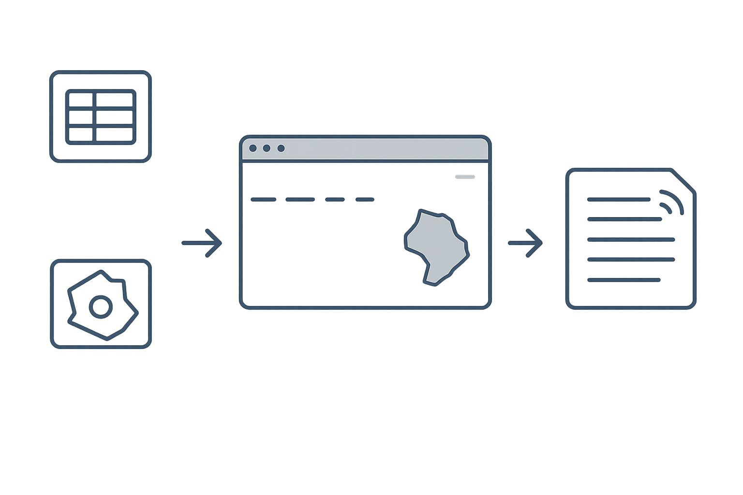



From Data to Insights with the vizTool
vizTool
Data Tables
INSIGHTS
Planner Exploring Information
Insights
Geometry
Notes:
The vizTool is designed to reveal insights from existing data, not to perform analysis itself. The app reads in tables and spatial data to build interactive maps and charts. By combining these elements, planners can explore information visually, uncover patterns, and find stories in the data that support better decision-making.

Slide 6










vizTool Building Blocks
Data Files
Application
Hosting
Notes:
The vizTool is built from a few simple components. Data comes in through JSON and GeoJSON files, which provide both tabular and spatial inputs. The application itself is powered by the ArcGIS Maps SDK for JavaScript, enhanced with the Calcite Design System for a clean interface, and Chart.js for generating interactive charts. These pieces are lightweight and accessible, relying on free developer tools and CDN hosting. Finally, the app can run locally on a laptop or desktop or be deployed to a web server for broader access.

Slide 7
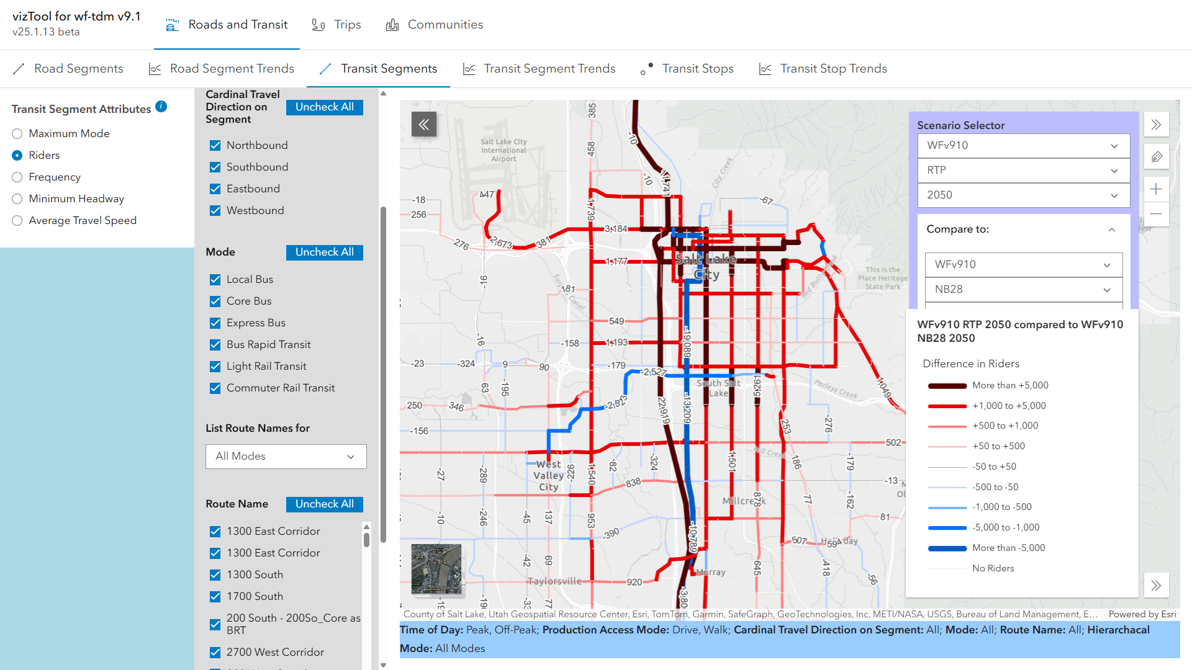
Comparing Transit Scenarios–RTP vs No-Build
Notes:
The vizTool makes it easy to compare different transit scenarios side by side. In this example, the RTP 2050 scenario is compared against a No-Build alternative, with changes in ridership displayed directly on the map. Red lines highlight corridors with projected increases in riders, while blue lines show decreases. This visual approach helps planners quickly see where investments may have the greatest impact.

Slide 8
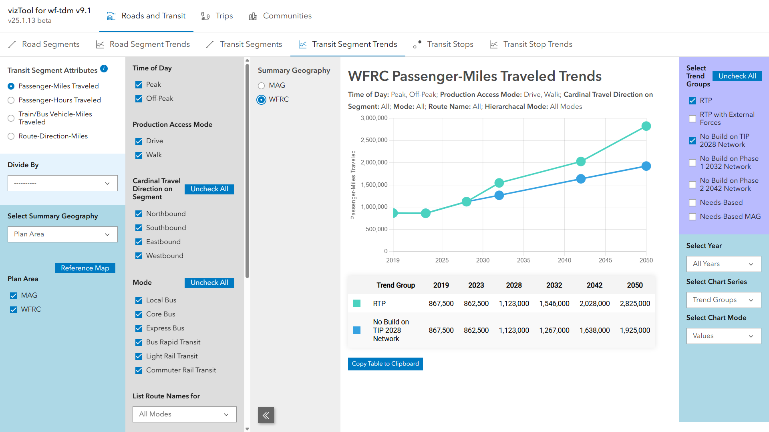
Comparing Transit Scenarios–RTP vs No-Build
Notes:
The vizTool provides a range of options for exploring results. Filters allow users to drill down by time of day, access mode, or transit mode, while the summary geography option makes it easy to compare results across different TAZ aggregations, such as city or county level. Users can also toggle between different chart series and chart modes, such as stacked charts, giving planners the ability to tailor the analysis to specific questions.

Slide 9
Some of Our Uncovered Insights
Vehicle ownership model is sensitive to land use, but previous land use scenarios weren’t ambitious enough.
When we intensified land use around LRT/BRT stations for new transit lines, we found:
Increased density around stations alone isn’t enough for LRT/BRT ridership.
LRT/BRT performs much better when connected to multiple transit lines and more intense land use along corridor.
Notes:
The vizTool makes additional analysis possible. Before, we didn’t have time to explore beyond the standard outputs. Now, we can filter, visualize, and quickly see patterns that lead to new insights.
And quickly, from exploring some new scenarios with this tool, two insights stood out. First, our vehicle ownership model is sensitive to land use, but the scenarios we had previously tested weren’t ambitious enough to shift results—whereas more aggressive land use changes did produce noticeable effects. Second, adding density just around LRT or BRT stations wasn’t enough. Stronger results came when new lines were connected to multiple routes and paired with more intensive land use along the corridor.

Slide 10

Let’s keep talking over at the BOB DYLAN table!
How can you improve your visualizations?
Bill Hereth — bill.hereth@wfrc.utah.gov
Suzie Swim — suzie.swim@wfrc.utah.gov
Notes:
Thanks so much for your time and attention today. We’ve really only scratched the surface of what the vizTool can do, and we’d love to continue the conversation.
If you’d like to see a demo, ask questions, or just chat more about how we can all improve the way we visualize model outputs, please come find us at the Bob Dylan table. Suzie and I will both be there, and we’d be happy to walk you through the tool in more detail, or hear about the approaches you’re using in your own work.
And if you can’t make it to the table, no problem — feel free to reach out to us by email. We’d love to connect and keep the conversation going.

